Slide 1

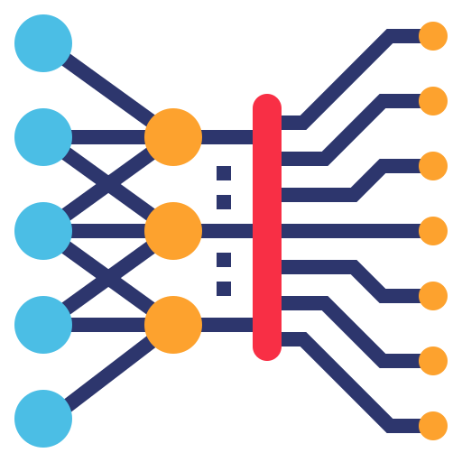
Graph Convolutional Networks (GCNs)
Introduction to GCNs
Ikne Omar
01.12.2023
Notes:
Presentation

Slide 2
Contents
Why graphs ?
Fundamentals of graph structures.
Basic concepts
Graph data representation
Frameworks & utils
From CNNs to GCNs
Convolution on images
Convolution on graphs
GCNs
Tasks on graphs
Training GCNs
Practical advices
Take home notes
Practical example

Slide 3
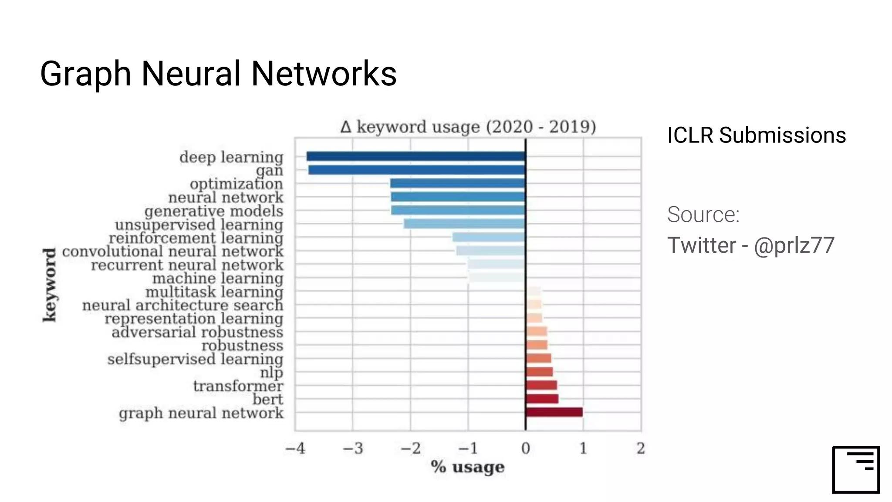
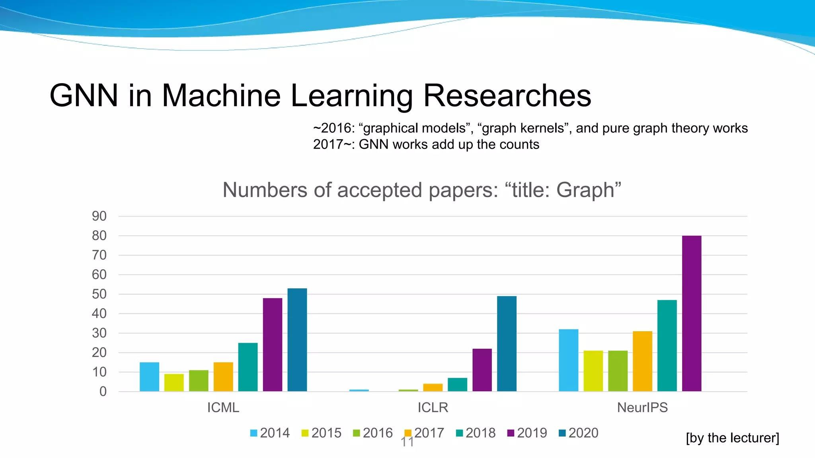
First, a few statistics
Number of accepted papers
Title: “Graph”
ICLR submissions
ICML: International Conference on Machine Learning (rank A)
ICLR: International Conference on Learning Representations (rank A*)
NeurIPS: Neural Information Processing Systems (rank A*)

Slide 4
Why graphs ?

Slide 5
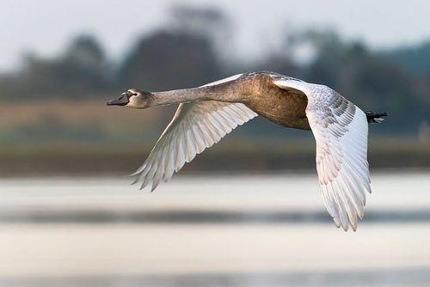
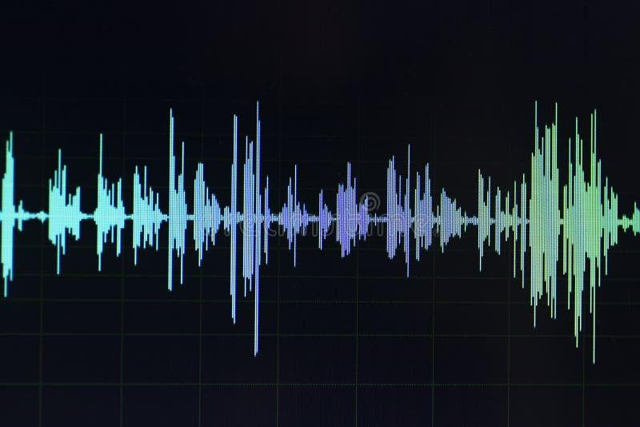
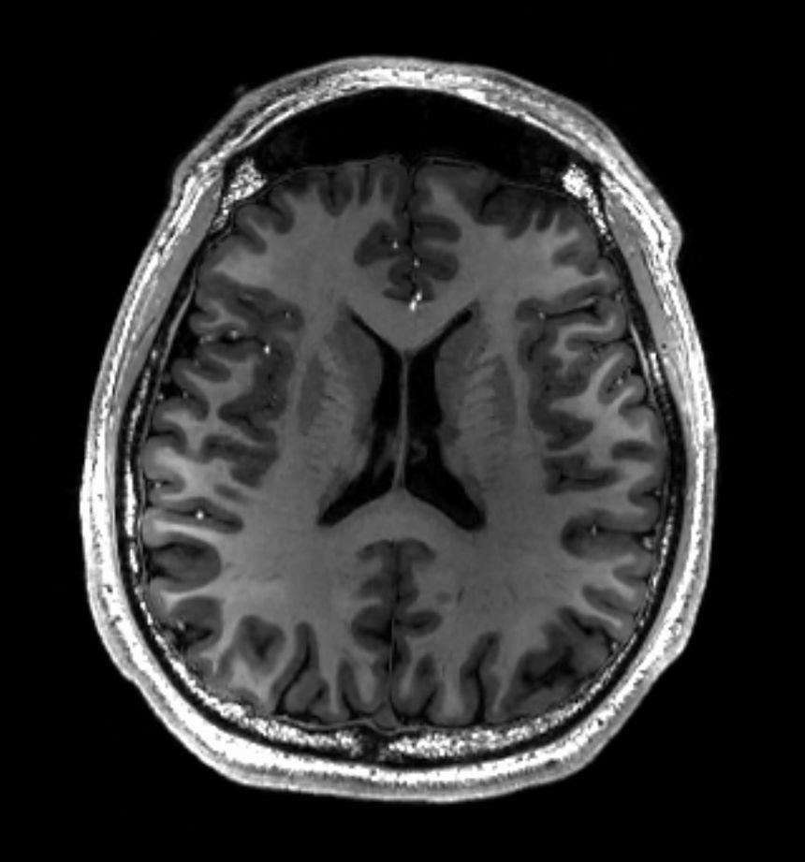
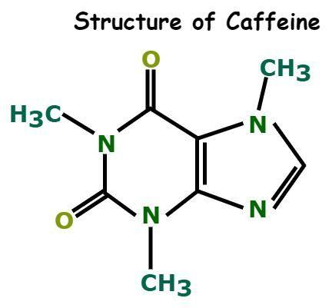
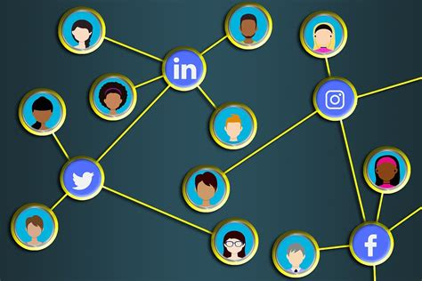
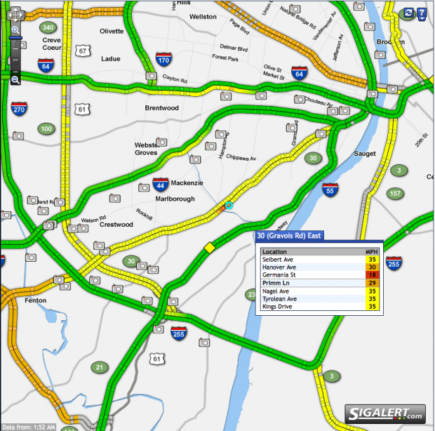
Understanding Connectivity: Explore data beyond tabular and image formats
Image & sequential data…
Graph structure data…

Slide 6
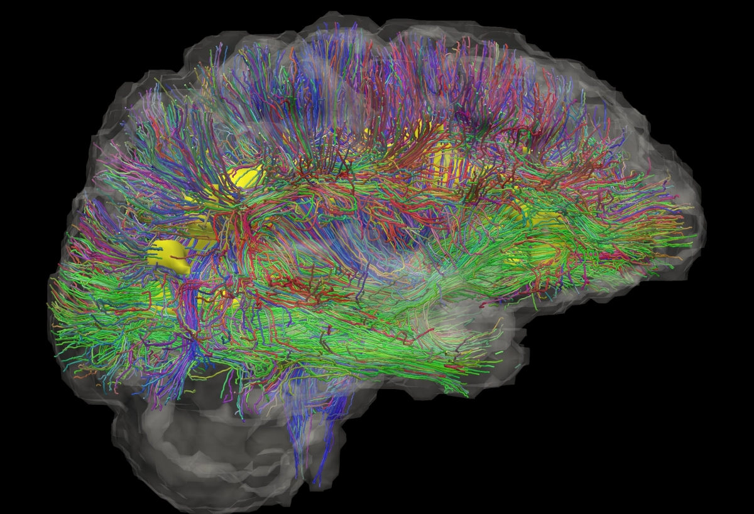
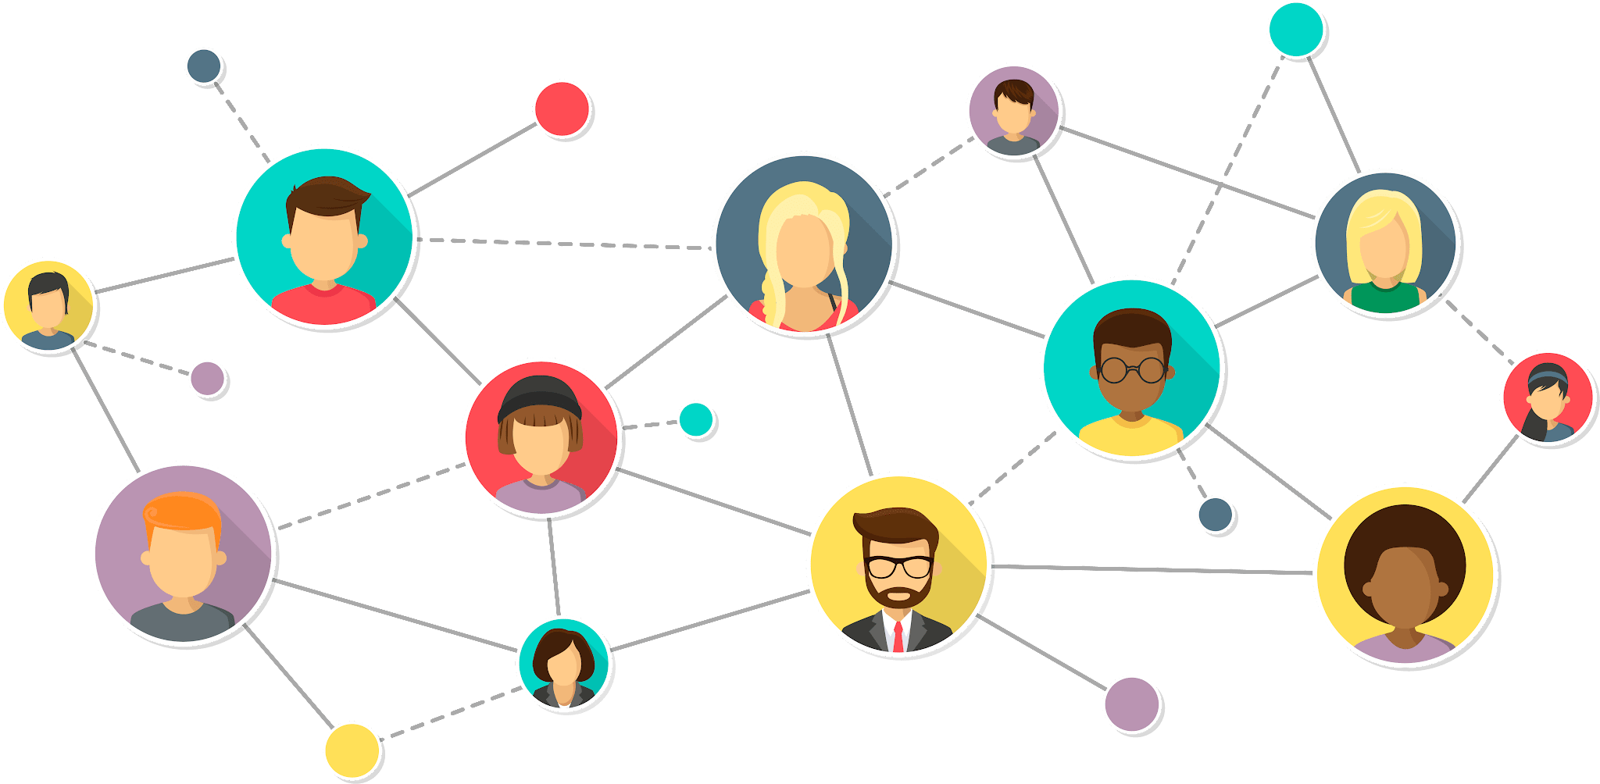
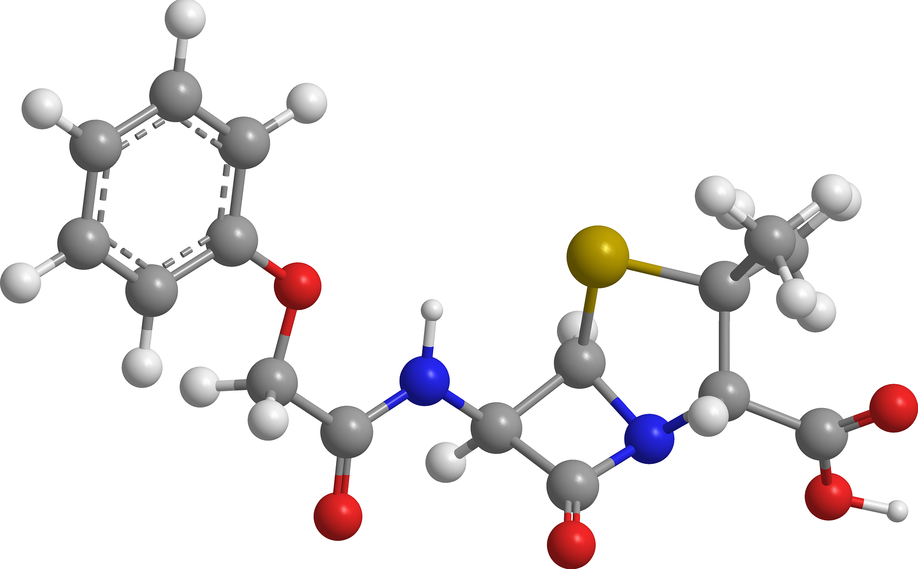
Graphs are everywhere !
Why Graphs?
Many problems are graphs in true nature. In our world, we see many data are graphs, such as molecules, social networks, and paper citations networks.

Slide 7
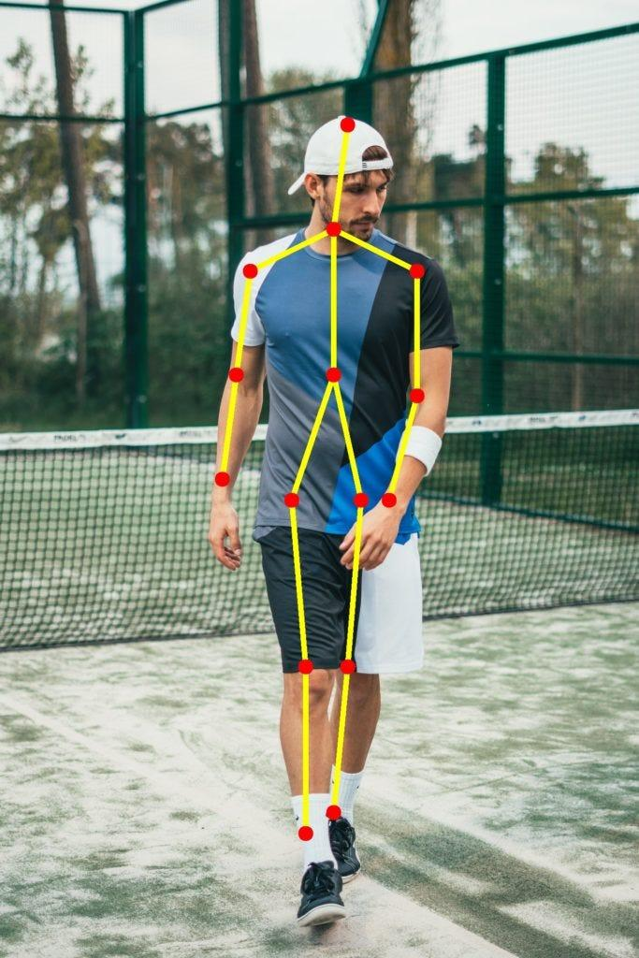
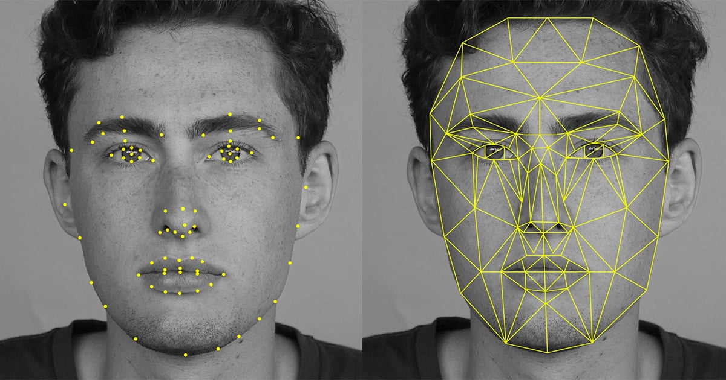
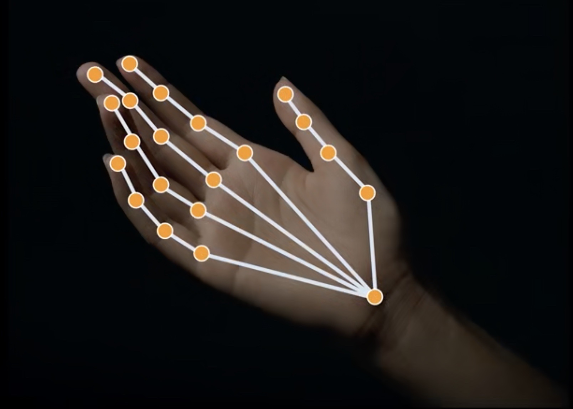
Graphs are everywhere !
Even humans can be seen as graphs !

Slide 8
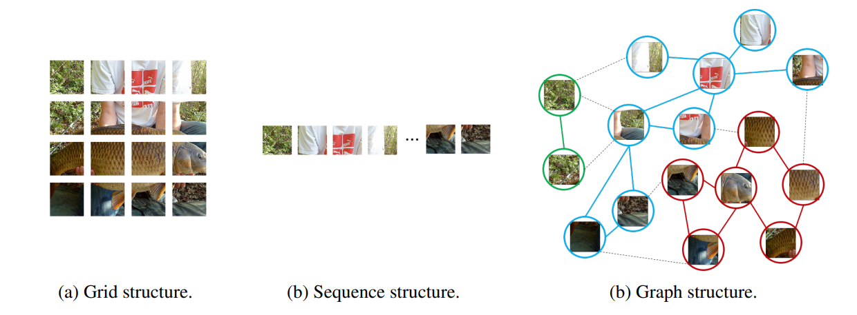
Graphs are everywhere !
Even more surprising! Any image can be considered a graph!

Slide 9
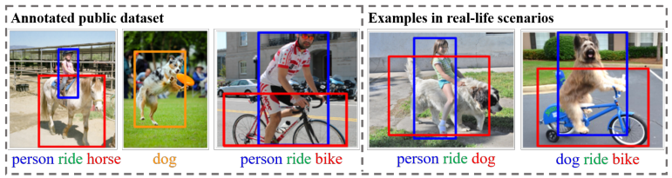
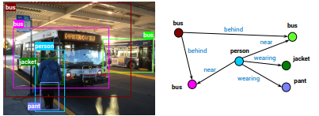
Graphs are everywhere !
Graphs are very useful in scene understanding
In a scene graph of an image:
Nodes: objects
Edges: relation between objects

Slide 10
2. Fundamentals of Graph Structure

Slide 11
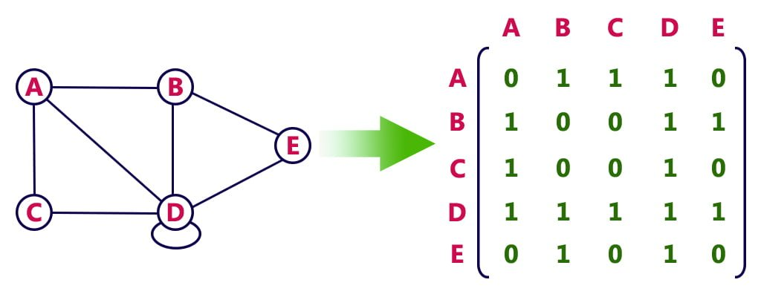
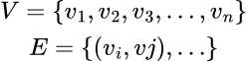
Graphs: Back to basics
What is a graph ?
A graph G=(V, E) is a set of points, called nodes or vertices (V), which are interconnected by a set of lines called edges (E).
Directed / Undirected
Weighted / Unweighted
What is an adjacency matrix ?
The adjacency matrix, also called the connection matrix, is a matrix containing rows and columns which is used to represent a graph connections, with 0 or 1 in the position of (vi , vj) according to the condition whether vi and vj are adjacent or not.

Slide 12
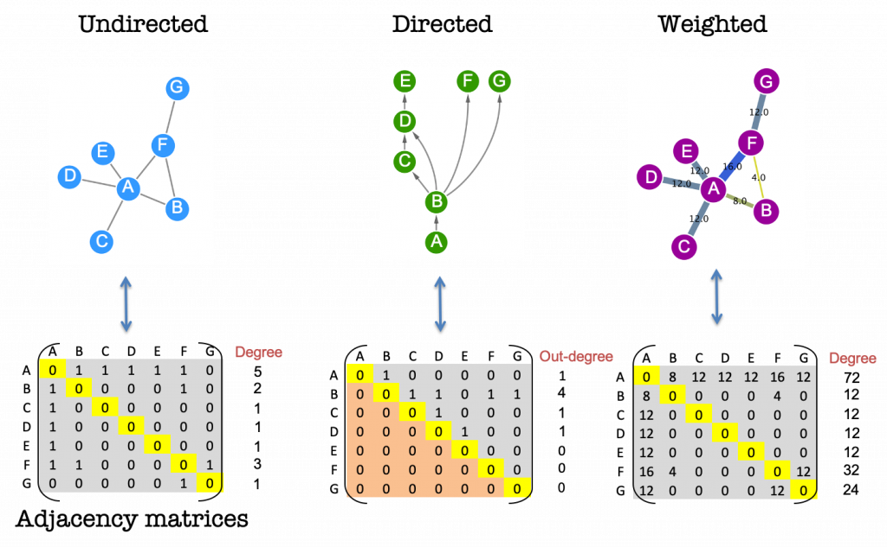
Graphs: Back to basics
Undirected (unweighted)
Directed (unweighted)
Weighted (undirected)

Slide 13
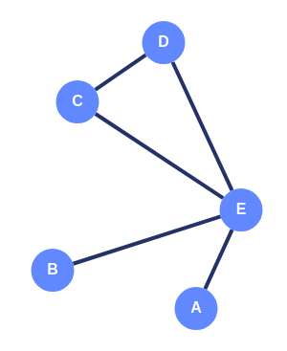
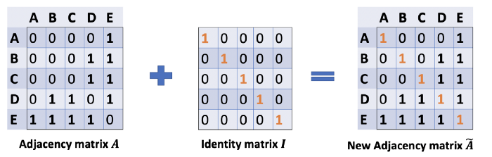
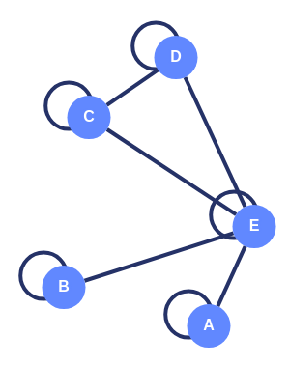
Graphs: Back to basics
Self-loops: Incorporating Node Information

Slide 14
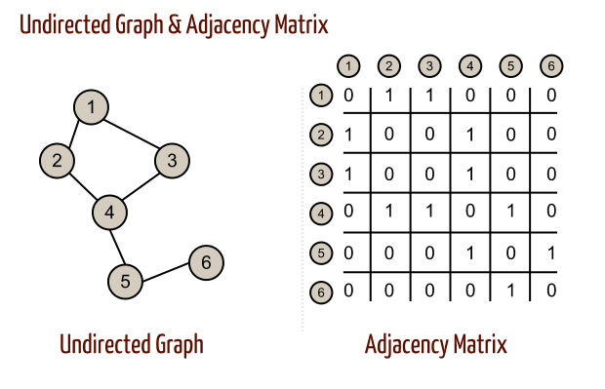
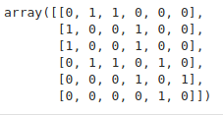
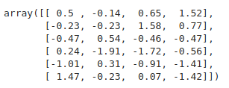
Graphs: Graph Data
Edges: Adjacency Matrix (A)
Nodes: Node Feature Matrix (X)
1
2
3
4
5
6
A: shape(6, 6)
X: shape(6, 4)

Slide 15

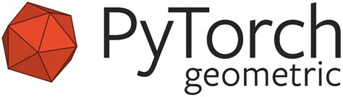
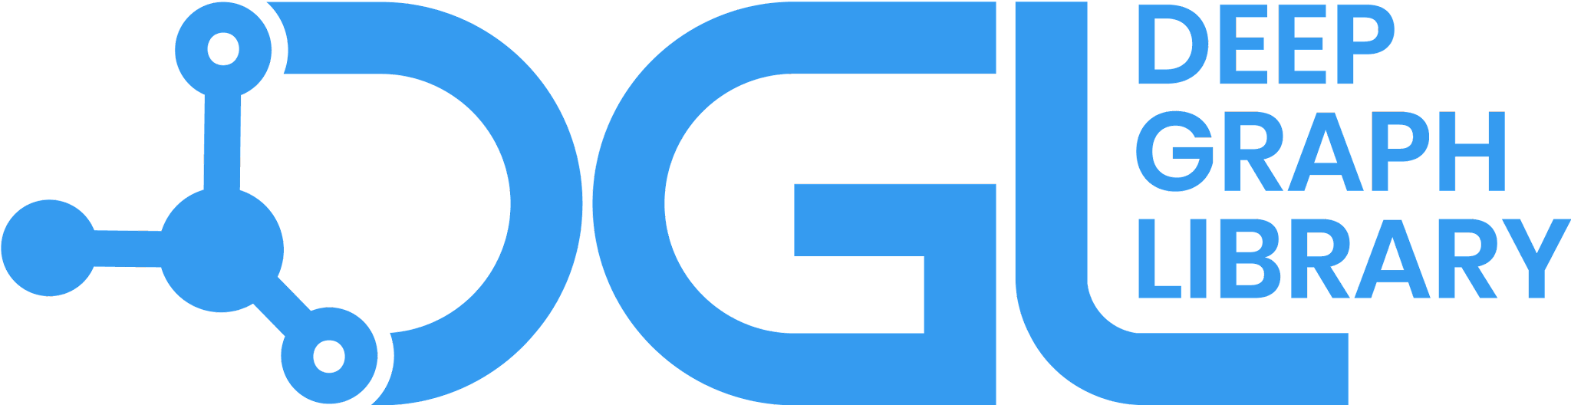
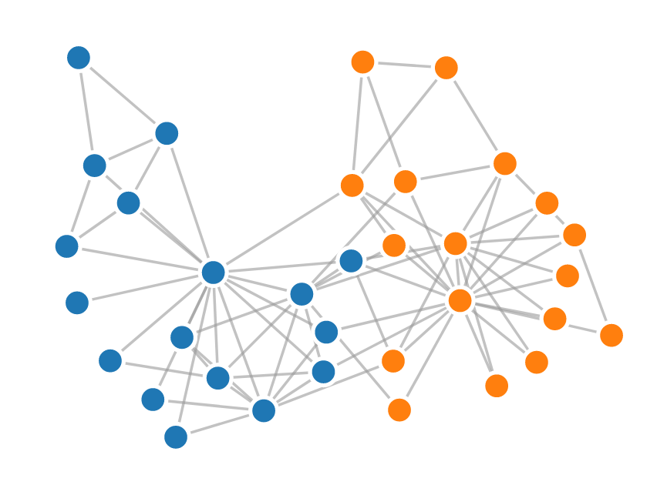
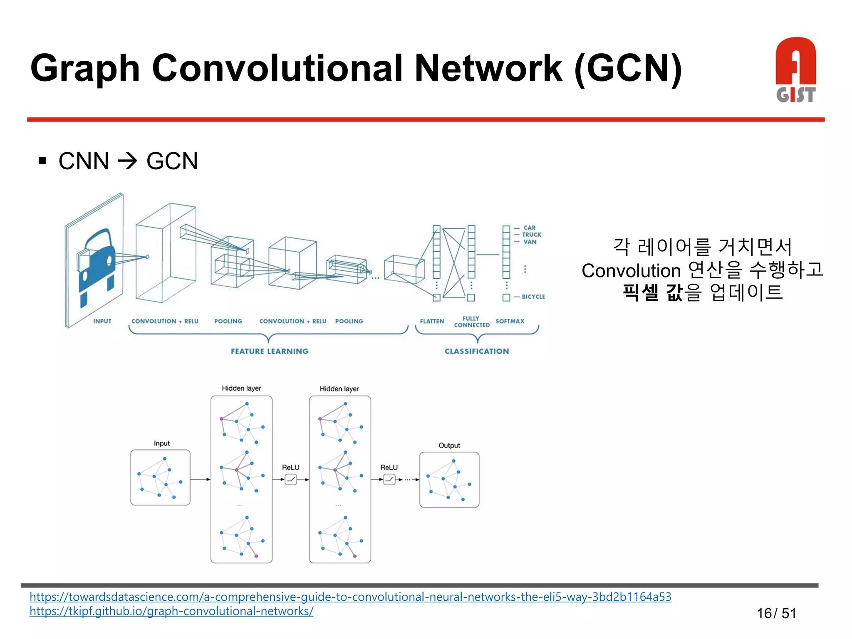
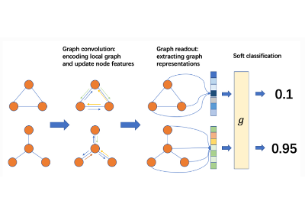
Graphs: Frameworks & utils
Store and mutate graphs
Predefined graph algorithms:
Shortest path
Dijkstra
Clustering
Centrality
Network analysis
Visualization tools
An extension library for pyTorch
Top-rated papers use it for implementation
Long list of ready-to-use methods and algos:
TransformerConf (2020)
GCN2Conv (2020)
DeeperGCN (2020)
…
Building Deep Learning models
Great tutorials
Generative graphs
Very useful for research and advanced tasks
Supports pyTorch and TensorFlow

Slide 16
3. From CNNs to GCNs

Slide 17

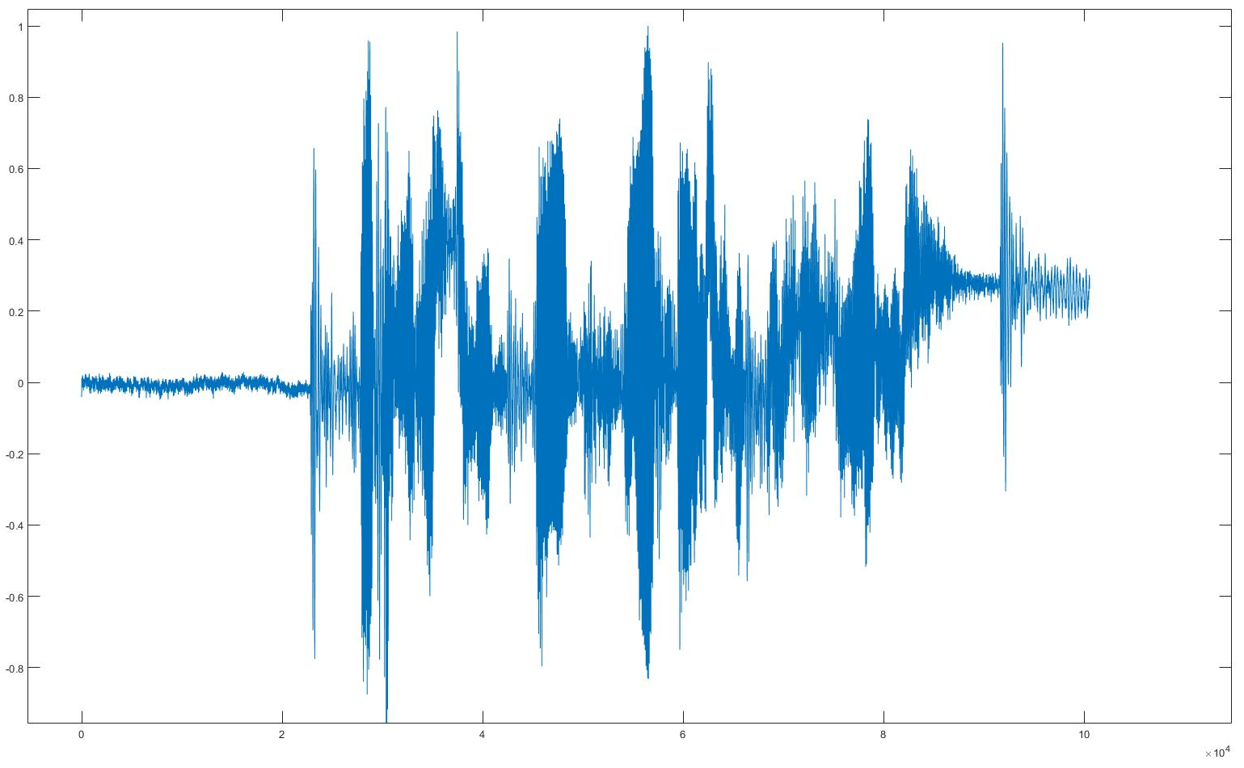
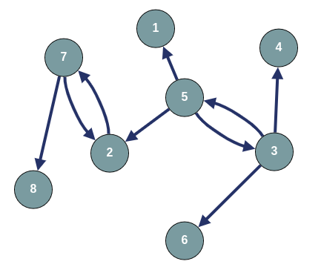
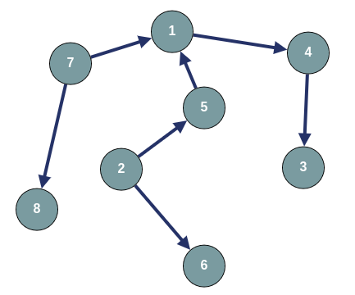
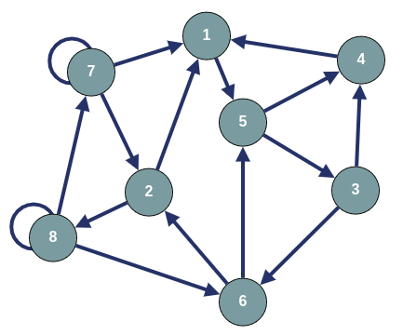
Image/Sequence vs. Graph Data
Sequential & image data…
Graphs
are
everywhere
!
Graph-like data…

Slide 18
From CNNs to GCNs
CNNs
CNNs leverage the convolutional operator to extract the spatial regularity of the images.
Graphs can be seen as a strict generalisation of images.
Consider any image as a grid graph.
Each pixel represents a node
Each pixel is adjacent to its 4/8 neighbours
Can we adapt the convolutions to operate on graph data ?
GCNs

Slide 19

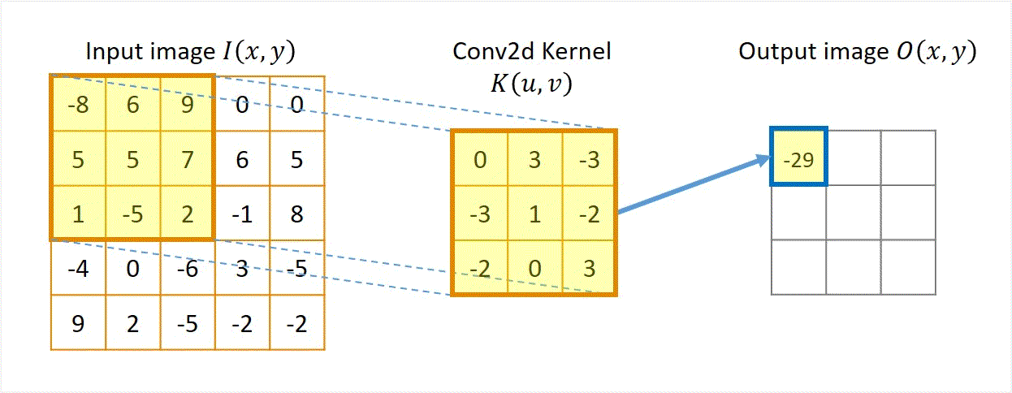
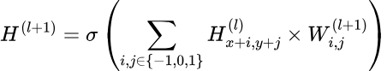
CNN: Convolution on Images
Convolution Neural Network (CNN)
Update Rule:
shift
input
kernel

Slide 20
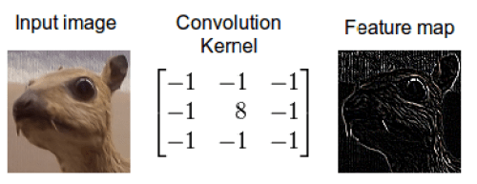
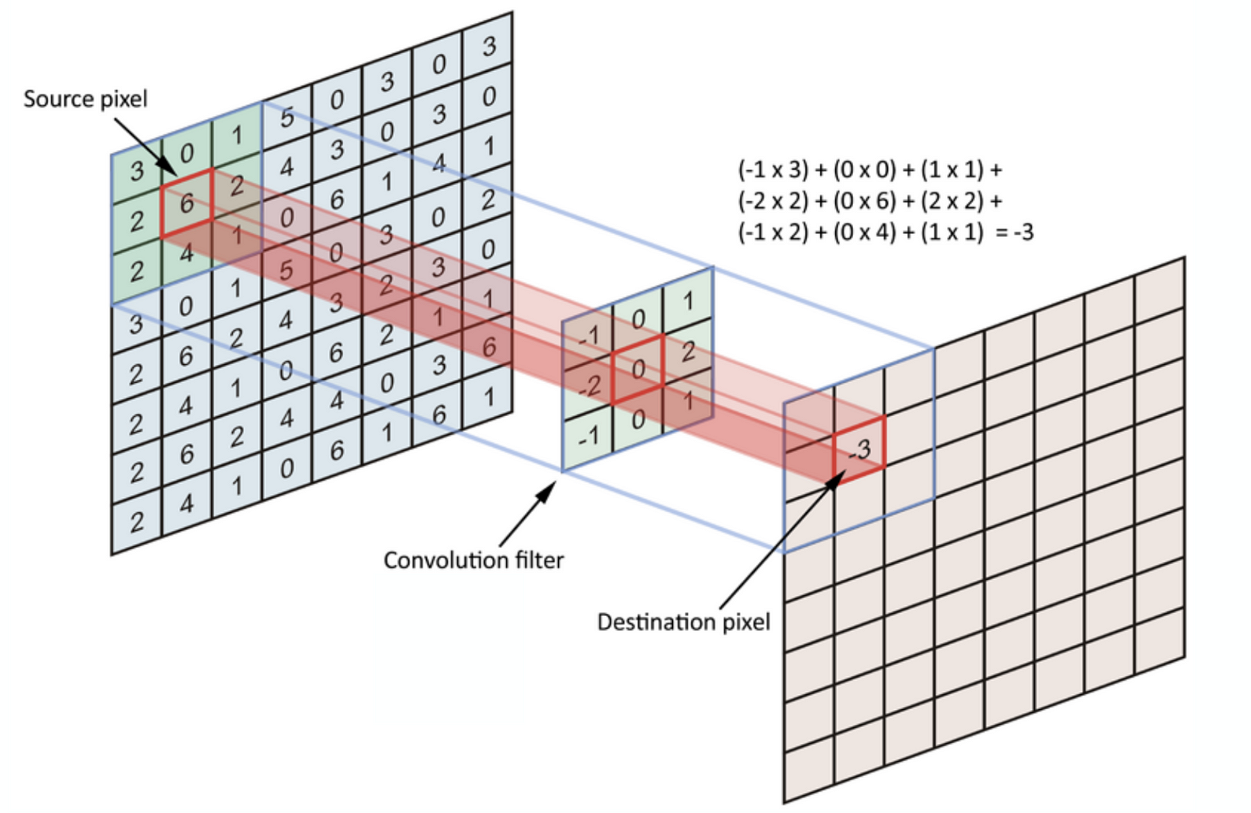
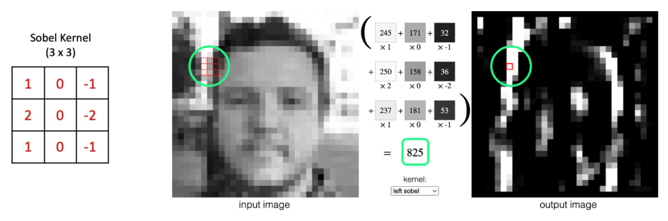
CCN: Convolution on Images
Convolutions capture local patterns and features in images.

Slide 21
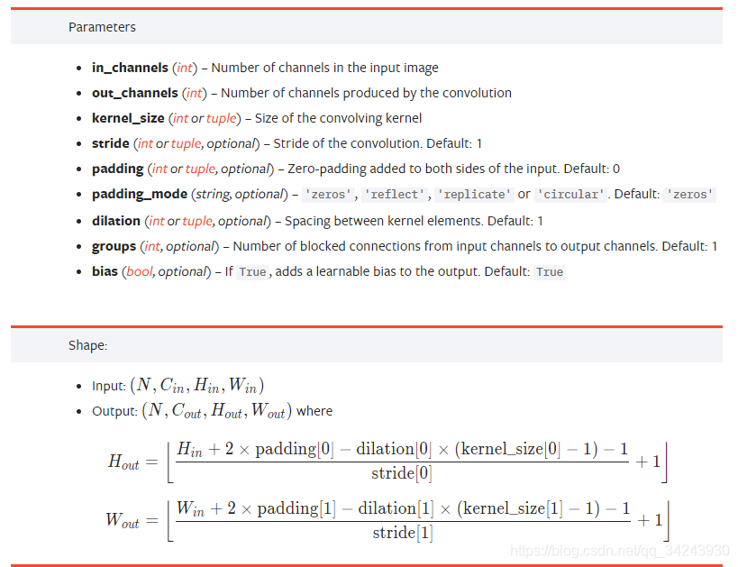
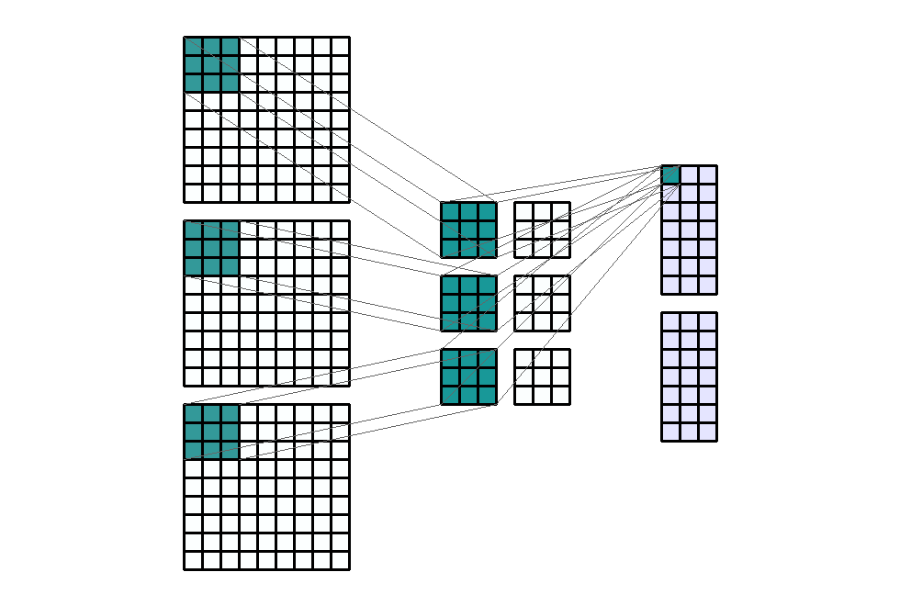
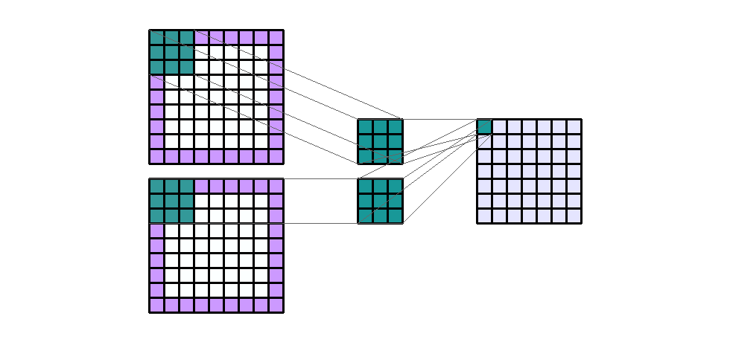
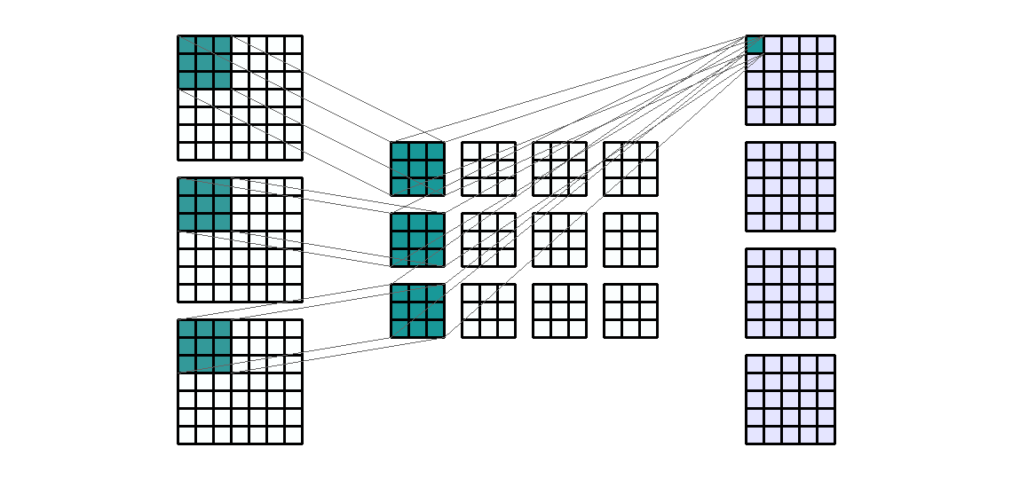
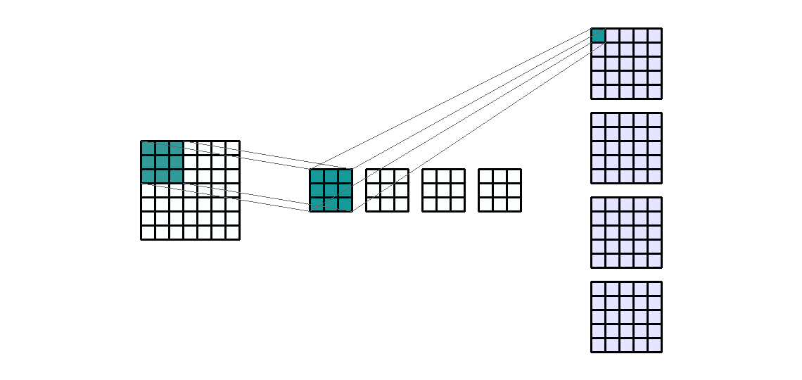
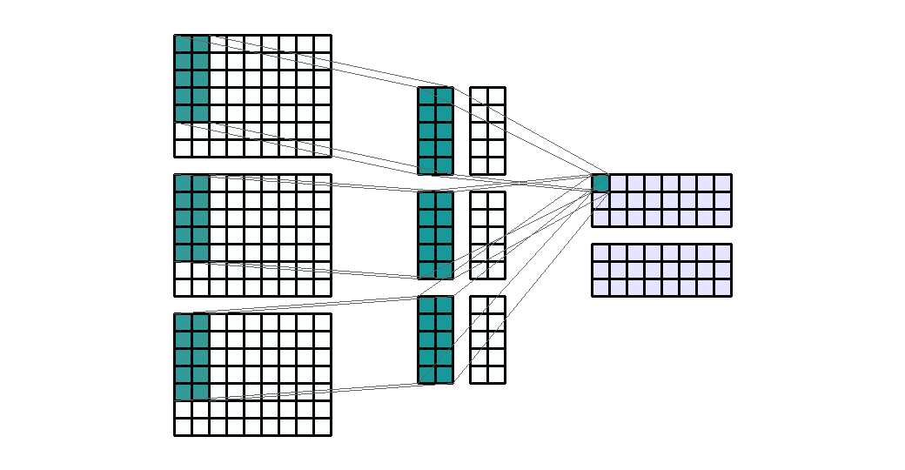
CCN: Convolution on Images
Convolutions Parameters:
Stride (stride = (1, 3))
Padding (padding = (1, 1))
Input channels (in_channels=3)
Output channels (out_channels = 4)
Kernel size (kernel_size = (2, 4))
Input: (2, 7, 7) — Output: (1, 7, 7) — K : (3, 3) — P : (1, 1) — S : (1, 1)
Input: (3, 7, 9) — Output : (2, 3, 9) — K : (5, 2)
Input Shape: (1, 7, 7) — Output Shape : (4, 5, 5) — K : (3, 3)
Input Shape: (3, 7, 7) — Output Shape : (4, 5, 5) — K : (3, 3)
Input: (3, 9, 9) — Output : (2, 7, 3) — K : (3, 3) — S : (1, 3)

Slide 22
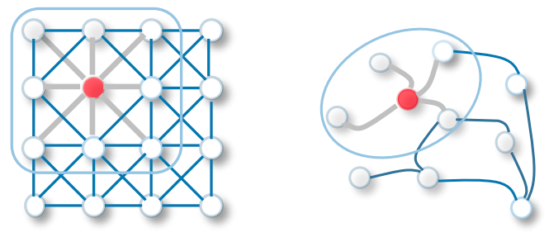
Convolution From Image to Graph ?
Convolution on images vs. on graphs
On images
What about graphs ?
Convolution works well on Euclidean data, such as image data.
Convolutions capture local patterns and features in images.
Convolutions provide a certain level of translation invariance
Graphs are non-Euclidean structured data! i.e. they have no “axes”.
What is a coordinate? And what is a shift?
Convolutions seem hard to apply to graphs!

Slide 23
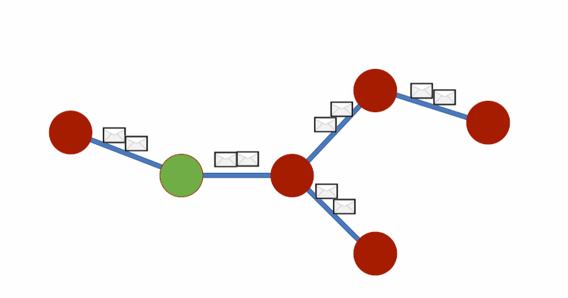
GCN: Convolution on graphs
Convolution can be referred to as Message Passing in GCNs.
Message passing is performed in the context of a node's local neighborhood.
Each node shares its current state with its neighbors, and each node’s new features are updated accordingly.
Message Passing

Slide 24
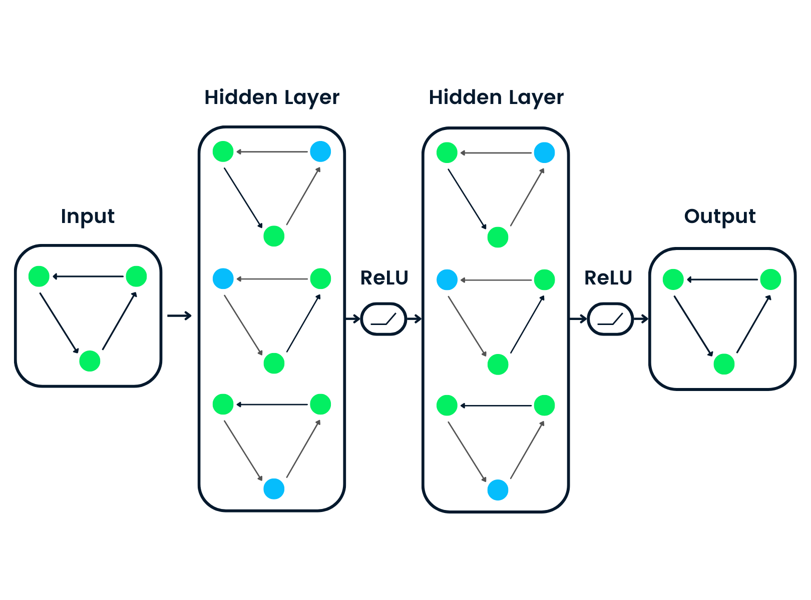




GCN: Convolution on graphs
Consider this undirected graph:
Calculate update for node in red:
Update Rule:
OR

Slide 25



GCN: Convolution on graphs
Why learning embeddings/representations ?
Projection to a Higher-Dimensional Space
The higher-dimensional space provides a richer representation that facilitates the learning of complex relationships and patterns in the graph-structured data.
The final layer's output can be seen as an embedding of nodes in a latent space, where nodes with similar roles or functions in the graph are close together.

Slide 26




GCN: Convolution on graphs
Point E: [3, 2]
Let's take a look at an example!
Point B: [8, 9]
Do the maths !
Given the following paper citation graph. Write down the corresponding adjacency matrix A and the features matrix X.
Point A: [5, 8]
Point D: [3, 1]
Point C: [7, 3]
Simplified graph of a traffic network
Point X: [road capacity, traffic jam factor]
?

Slide 27



GCN: Convolution on graphs
Point E: [3, 2]
If we add self-loops !
Point B: [8, 9]
Point A: [5, 8]
Point D: [3, 1]
Point C: [7, 3]
Simplified graph of a traffic network
Point X: [road capacity, traffic jam factor]

Slide 28


To sum up, convolutional operator for Image vs. Graph
Convolutions on images vs. on graphs

Slide 29
To sum up, convolutional operator for Image vs. Graph
Convolutions on images vs. on graphs
Local Receptive Fields:
Convolutional operations are applied using small filters (kernels) that slide over the input image.
Each filter looks at a local receptive field (a small region of the image).
Parameter Sharing:
Parameters (weights) of the filters are shared across the entire image.
The same set of weights is applied to different local receptive fields.
Aggregation of Information:
Aggregate information by computing a weighted sum of the values in the receptive field.
Local Neighborhoods:
Message passing occurs over the graph structure where nodes represent entities, and edges represent relationships.
Message passing is performed in the context of a node's local neighborhood.
Parameter Sharing:
GCNs use learnable parameters (weights) associated with edges to determine how information is shared between connected nodes.
The same set of parameters is shared across all nodes in the graph.
Aggregation of Information:
Aggregation is typically performed by computing a weighted sum of neighbor node features.

Slide 30



GCNs: Convolutional Operator
Graph convolution implementation in pytorch:
Shapes:
n: number of nodes
d: in_features
d’: out_features
Mathematically:

Slide 31
4. GCNs: Practical Aspects

Slide 32

Tasks on Graphs

Slide 33


Tasks on Graphs: Node classification
Node classification: Predict a type of a given node
e.g., Malicious users in a social network, community clustering, etc

Slide 34


Tasks on Graphs: Link prediction
Link prediction: Predict whether two nodes are linked
e.g., protein-protein interaction, friend suggestion, etc

Slide 35


Tasks on Graphs: Graph classification
Graph classification: Predict the class of a given graph
e.g., type of a chemical molecule, gesture recognition, etc.

Slide 36



Tasks on Graphs: Graph Generation
Graph generation: generate a graph given an input data.
e.g., interactions learning, molecule generation, interactions sparsifying, etc.

Slide 37

Overall Structure of GCN
Depending on the downstream task, we adjust this part:
Node classification
Graph classification
Graph generation
etc.
Activation
Inputs
Graph representation learning
Aggregation
Mean, Sum, Max-pooling
Graph Classification

Slide 38

Basic GCN Implementation
Parameters:
in_dim: number of features of X
n_nodes: number of nodes in the graph.
hidden_dim: embedding dimension
n_gcn_layers: number of convolutional layers
n_classes: number of classes

Slide 39
Training GCNs: Key considerations
4
1
Graph Convolution Layers
Structure of a GCN layer
Weight matrices, activation functions
Graph convolution operation
Data Preprocessing
Normalize node features
Handle missing data
Normalize the graph
GCN
Training
2
5
Neighborhood Aggregation
Choose aggregation functions (e.g., mean, attention)
Impact on information propagation
Depth of the Model
Number of convolution layers
Trade-off between complexity and overfitting
3
Graph Construction
Create the adjacency matrix
Choose the graph structure (spatial, temporal, etc.)
Handle directed/undirected edges

Slide 40


Practical advices
Potential Pitfalls when going deep:
Vanishing gradient
Overfitting
Over-smoothing: node vectors become too similar
Bottleneck(over-squashing): a single node vector contains data of too many nodes

Slide 41

More advanced GCNs variantes
GraphSAGE (Graph Sample and Aggregated)
"Inductive Representation Learning on Large Graphs" by Hamilton et al. (2017).
Key Idea:
GraphSAGE addresses scalability issues by sampling a fixed-size neighborhood around each node during training. It aggregates information from the sampled neighbors, allowing it to scale to large graphs.

Slide 42

More advanced GCNs variantes
GAT (Graph Attention Network)
"Graph Attention Networks" by Velickovic et al. (2018).
Key Idea:
GAT introduces attention mechanisms to assign different weights to neighbors during aggregation, enabling nodes to selectively attend to more informative neighbors.

Slide 43

More advanced GCNs variantes
STGCN (Spatial Temporal Graph Convolutional Networks)
“Spatial Temporal Graph Convolutional Networks for Skeleton-Based Action Recognition” by Yan et al. (2018).
Key idea:
STGCN incorporates both spatial and temporal dependencies within a graph structure. It applies graph convolutions across both spatial and temporal dimensions. This enables the model to capture spatial dependencies between different locations as well as temporal dependencies over time.

Slide 44


More advanced GCNs variantes
SGCN (Sparse Graph Convolution Network)
“Sparse graph convolution network for pedestrian trajectory prediction” by Shi et al. (2021)
Key idea:
SGCNs are designed to be efficient for graphs with a sparse adjacency matrix. One of the main motivations for SGCNs is to reduce the computational complexity associated with standard GCNs, which involve matrix multiplications with the full adjacency matrix.

Slide 45
Challenges & Future Directions: What lies ahead
Scalability
Handling Noisy or Incomplete Graphs
Challenge: As the size of the graph increases, the computational and memory requirements for training and inference increases.
Future Direction: Developing scalable GCN variants or exploring techniques to efficiently handle large-scale graphs.
Challenge: Graphs in real-world applications often contain noise, missing edges, or incomplete information.
Future Direction: Developing GCN variants that are robust to noisy data or designing methods to impute missing information in graphs.
Generalization to Heterogeneous Data
Interpretable Graph Representations
Challenge: Generalizing GCNs to handle heterogeneous graphs with different types of nodes and edges is a challenge.
Future Direction: the development of more flexible and adaptive architectures to handle heterogeneous graphs.
Challenge: Understanding and interpreting the learned representations in GCNs can be challenging, especially in complex, high-dimensional graphs.
Future Direction: Exploring techniques for interpretability and visualization of graph representations.

Slide 46

Take home notes
GCNs are used for learning on the graph.
GCNs use both node features and the structure for the training
The main idea of the GCN is to take the weighted average of all neighbors’ node features (including itself): Lower-degree nodes get larger weights. Then, we pass the resulting feature vectors through a neural network for training.
We can stack more layers to make GCNs deeper. Normally, we go for 2 or 3-layer GCN.

Slide 47
Additional Resources
https://github.com/Jiakui/awesome-gcn
https://antonsruberts.github.io/graph/gcn/
https://ieeexplore.ieee.org/ielaam/5962385/9312808/9046288-aam.pdf
https://distill.pub/2021/gnn-intro/

Slide 48

Practical Example: GCN Training for Static Hand Gesture Recognition

